Slide 1
Mobile and Wireless Networks

Slide 2
Chapter 1: Introduction
Fundamentals
Electromagnetic spectrum
Radio propagation mechanisms
Characteristics of the wireless channel
Modulation techniques
Multiple access techniques
Voice coding
Error control
Computer networks
IEEE 802 Networking Standard
Wireless networks and book overview

Slide 3
Fundamentals
A computer network is an interconnected collection of autonomous computers.
Networking Goals:
  Resource sharing - e.g., shared printer, shared files.
  Increased reliability - e.g., one failure does not cause system failure.
  Economics - e.g., better price/performance ratio.
  Communication - e.g., e-mail.

Slide 4
Mobile communication
Two aspects of mobility:
  User mobility: users communicate (wireless) “anytime, anywhere, with anyone”
  Device portability: devices can be connected anytime, anywhere to the network
Wireless vs. mobile Examples
✗ ✗ stationary (wired and fixed) computer
✗ ✓ notebook in a hotel
✓ ✗ wireless LANs in historic buildings
✓ ✓ Personal Digital Assistant (PDA)
The demand for mobile communication creates the need for integration of wireless networks into existing fixed networks:
  Local area networks: standardization of IEEE 802.11,
  ETSI (European Telecommunications Standards Institute) (HIPERLAN - combined technology for broadband cellular short-range communications and wireless Local Area Networks (LANs) )
  Internet: Mobile IP extension of the Internet Protocol IP
  Wide area networks: e.g., internetworking of GSM and ISDN

Slide 5
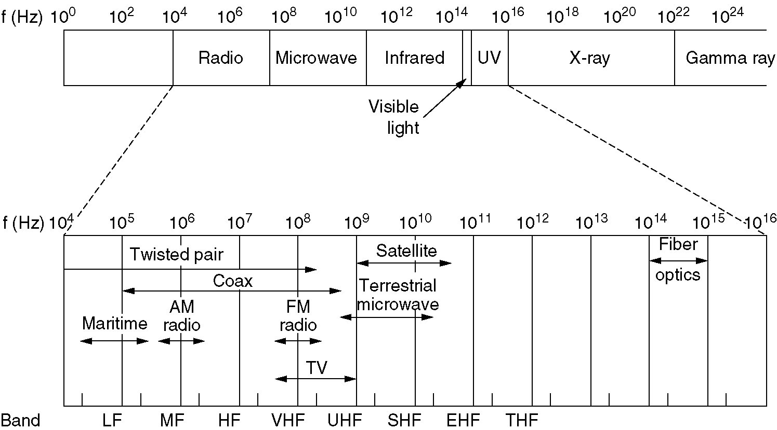
The Electromagnetic Spectrum
The electromagnetic spectrum and its uses for communication.

Slide 6
Electromagnetic spectrum
twisted pair
coax cable
optical transmission
1 Mm
300 Hz
10 km
30 kHz
100 m
3 MHz
1 m
300 MHz
10 mm
30 GHz
100 μm
3 THz
1 μm
300 THz
ELF
VF
VLF
LF
MF
HF
VHF
UHF
SHF
EHF
infrared
visible light
UV
ELF = Extremely Low Frequency (30 ~ 300 Hz) UHF = Ultra High Frequency (300 MHz ~ 3GHz)
VF = Voice Frequency (300 ~ 3000 Hz) SHF = Super High Frequency (3 ~ 30 GHz)
VLF = Very Low Frequency (3 ~ 30 KHz) EHF = Extremely High Frequency (30 ~ 300GHz)
LF = Low Frequency (30 ~ 300 KHz) Infrared (300 GHz ~ 400 THz)
MF = Medium Frequency (300 ~ 3000 KHz) Visible Light (400 THz ~ 900 THz)
HF = High Frequency (3 ~ 30 MHz) UV = Ultraviolet Light (900 THz ~ 10¹⁶ Hz)
VHF = Very High Frequency (30 ~ 3000 MHz) X-ray (10¹⁶ ~ 10²² Hz)
Gamma ray (10²² Hz ~)
Frequency and wave length: λ = c/f
wave length λ, speed of light c ≅ 3x10⁸m/s, frequency f

Slide 7
Electromagnetic spectrum
The Electromagnetic spectrum is used for information transmission by modulating the amplitude, frequency, or phase of the waves.
VLF, LF, and MF are called as ground waves.
  Transmission range up to a hundred kilometers
  Used for AM radio broadcasting
HF and VHF
  The sky wave may get reflected several times between the Earth and the ionosphere.
  Used by amateur ham radio operators and for military communication.
VHF-/UHF-ranges for mobile radio
  simple, small antenna for cars
  deterministic propagation characteristics, reliable connections

Slide 8
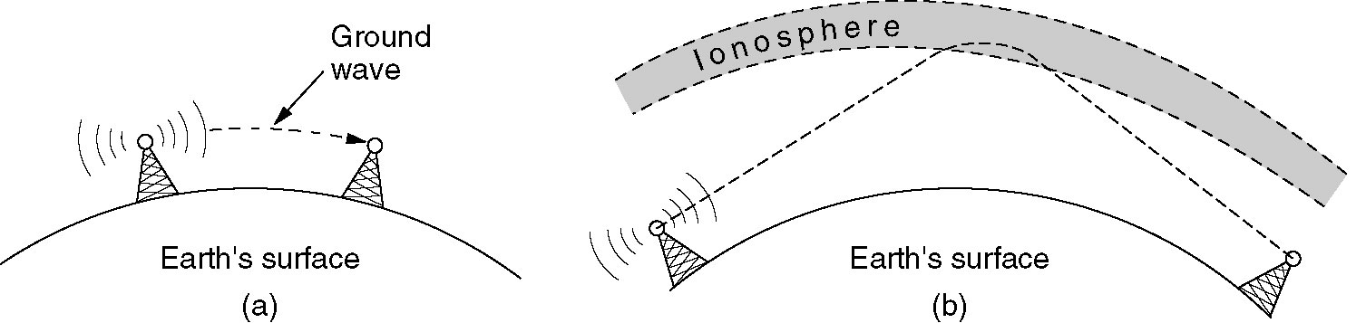
Radio Transmission
(a) In the VLF, LF, and MF bands, radio waves follow the curvature of the earth.
(b) In the HF band, they bounce off the ionosphere.

Slide 9
Electromagnetic spectrum
SHF and higher for directed radio links, satellite communication
  small antenna, focusing
  Microwave transmissions travel in straight lines.
  High signal-to-noise ratio (SNR)
  Line-of-sight alignment is required.
  large bandwidth available
Wireless LANs use frequencies in UHF to SHF spectrum
  some systems planned up to EHF
  limitations due to absorption by water and oxygen molecules (resonance frequencies)
    weather dependent fading, signal loss caused by heavy rainfall etc.
Infrared waves and waves in the EHF band are used for short-range communication.
  Widely used in television, VCR, stereo remote controls
Visible light
  Used in the optical fiber
  Laser can be used to connect LANs on two buildings but can travel limited distance and cannot penetrate through rain or thick fog.

Slide 10
Spectrum Allocation
Spectrum allocation methods:
  Comparative binding (beauty contest) requires each carrier to explain why its proposal serves the public interest best.
  Lottery system
  Auction
The other option of allocating frequencies is not to allocate them.
ITU (International Union Radiocommunication) has designated ISM (industrial, scientific, medical) bands as open bands:
  Frequencies are not allocated but restrained in a short range.
  These bands usually used by wireless LANs and PANs are around the 2.4 GHz band.
  Parts of the 900 MHz and 5 GHz bands are also available for unlicensed usage.

Slide 11
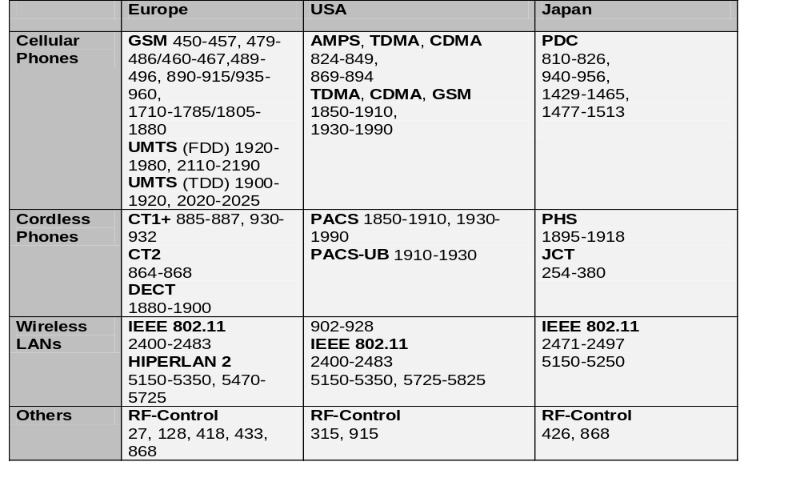
Spectrum Allocation
ITU-R holds auctions for new frequencies, manages frequency bands worldwide (WRC, World Radio Conferences)

Slide 12
Signals
physical representation of data
function of time and location
signal parameters: parameters representing the value of data
classification
  continuous time/discrete time
  continuous values/discrete values
  analog signal = continuous time and continuous values
  digital signal = discrete time and discrete values
signal parameters of periodic signals:
period T, frequency f=1/T, amplitude A, phase shift ϕ
  sine wave as special periodic signal for a carrier:
  s(t) = A_{t} sin(2 π f_{t} t + ϕ_{t})

Slide 13
Signals
Different representations of signals
  amplitude (amplitude domain)
  frequency spectrum (frequency domain)
  phase state diagram (amplitude M and phase ϕ in polar coordinates)
Composed (multiple frequencies) signals transferred into frequency domain using Fourier transformation
Digital signals need
  infinite frequencies for perfect transmission (Fourier equation)
  modulation with a carrier frequency for transmission (analog signal!)
A [V]
A [V]
Q = M sin ϕ
t[s]
ϕ
I= M cos ϕ
ϕ
f [Hz]

Slide 14
Signal propagation ranges
Transmission range
  communication possible
  low error rate
Detection range
  detection of the signal
  possible
  no communication
  possible
Interference range
  signal may not be
  detected
  signal adds to the
  background noise
sender
transmission
distance
detection
interference

Slide 15




Radio propagation
Radio waves can be propagated and receiving power is influenced in different ways:
  Direct transmission (path loss, fading dependent on frequency)
  Reflection at large obstacles
  Refraction through different media
  Scattering at small obstacles
  Diffraction at edges
  shadowing
Propagation in free space is always like light (straight line).
Receiving power proportional to 1/d² (d = distance between sender and receiver)
shadowing
reflection
refraction
scattering
diffraction

Slide 16
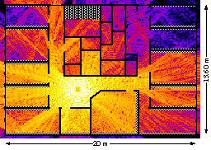
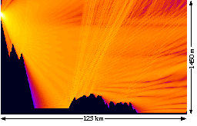
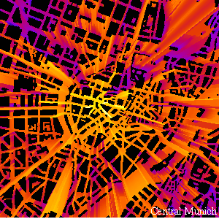
Radio propagation - example

Slide 17
Characteristics of the Wireless Channel
Path loss: the ratio of the power of the transmitted signal to the power of the same signal received by the receiver.
  Free space model: Assume there is only a direct-path between the transmitter and the receiver.
  Two-way model: Assume there is a light-of-sight path and the other path through reflection, refraction, or scattering between the transmitter and the receiver
  Isotropic antennas (in which the power of the transmitted signal is the same in all direction): The receiving power varies inversely to the distance of power of 2 to 5.
Fading: fluctuations in signal strength when received at the receiver.
  Fast fading/small-scale fading: rapid fluctuations in the amplitude, phase, or multipath delays.
  Slow fading/large-scale fading (shadow fading): objects that absorb the transmissions lie between the transmitter and receiver.

Slide 18
Characteristics of the Wireless Channel
Measures used for countering the effects of fading are diversity and adaptive modulation.
  Diversity modulation:
    Time diversity: spread the data over time.
    Frequency diversity: spread the transmission over frequencies. Example: the direct sequence spread spectrum and the frequency hopping spread spectrum.
    Space diversity: use different physical transmission paths. An antenna array could be used.
  Adaptive modulation: the transmitter adjusts the transmission based on the feedback from the receiver.
    Complex to implement

Slide 19
Characteristics of the Wireless Channel
Interference
  Adjacent channel interference: interfered by signals in nearby frequencies. Solved by the guard bands.
  Co-channel interference: narrow-band interference due to other systems using the same frequency. Solved by multiuser detection machenisms, directional antennas, and dynamic channel allocation methods.
  Inter-symbol interference: distortion in the received signal caused by the temporal spreading and the consequent (neighbor) overlapping of individual pulses in the signal. Solved by adaptive equalization that involves mechanisms for gathering the dispersed symbol energy into its original time interval.
Doppler Shift
  The change/shift in the frequency of the received signal when the transmitter and the receiver are mobile to each other.
  Moving towards each other, the frequency will be higher; two moving away, the frequency will be lower.

Slide 20

Multipath propagation
Signal can take many different paths between sender and receiver due to reflection, scattering, diffraction.
Time dispersion: signal is dispersed over time
➔ interference with “neighbor” symbols, Inter Symbol Interference (ISI)
The signal reaches a receiver directly and phase shifted
➔ distorted signal depending on the phases of the different parts
multipath
pulses
LOS pulses
signal at sender
signal at receiver

Slide 21
Characteristics of the Wireless Channel
Transmission Rate Constraints
  The number of times of signal changes is called the baud rate. Bit rate = baud rate x bits per signal
  Nyquist’s Theorem for noiseless channel:
    If the signal has L discrete levels over a transmission medium of bandwidth B , the maximum data rate C = 2B log₂ L bits/sec
    Example: a noiseless 3-kHz channel cannot transmit binary signals at a rate exceeding 6000 bps (= 2 x 3000 log₂ 2).
  Shannon’s Theorem for noisy Channel
    maximum data rate C = B log₂ (1 + S/N) bits/sec B: bandwdith, S: signal power, N: noise power
    S/N (Signal-to-noise ratio, SNR), usually measured as 10 log₁₀S/N in db = decibels, is called thermal noise ratio.
    Example: SNR = 20 db, 2 KHz bandwidth. The maximum data rate is 2000 x log₂ (1 + 100) = 9230.241 bps

Slide 22
Modulation Techniques
Analog modulation
  Used for transmitting analog data.
  shifts center frequency of baseband signal up to the radio carrier
Analog modulation techniques
  Amplitude Modulation (AM): Not efficient. Example: Broadcast radio
  Frequency Modulation (FM): Example: Broadcast radio
  Phase Modulation (PM)
Digital modulation
  digital data (0 and 1) is translated into an analog signal (baseband)
  Required if digital data has to be transmitted over a media that only allows for analog transmission - old analog telephone system and wireless networks
Analog modulation techniques
  Amplitude Shift Keying (ASK), Frequency Shift Keying (FSK), Phase Shift Keying (PSK)
  differences in spectral efficiency, power efficiency, robustness

Slide 23
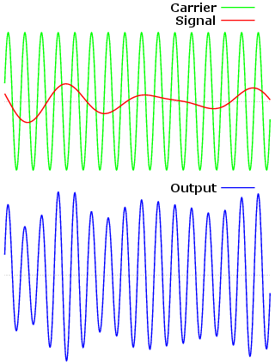
Modulation Techniques
An example of amplitude modulation (AM):
  The top diagram shows the modulating signal superimposed on the carrier wave.
  The bottom diagram shows the resulting amplitude-modulated signal. Notice how the peaks of the modulated output follow the contour of the original, modulating signal.

Slide 24
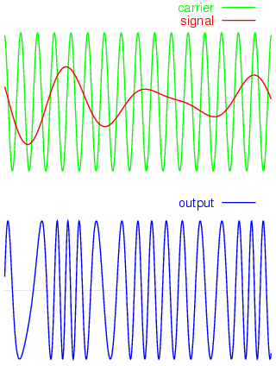
Modulation Techniques
An example of frequency modulation (FM).
  The top diagram shows the modulating signal superimposed on the carrier wave.
  The bottom diagram shows the resulting frequency-modulated signal.

Slide 25
Modulation and demodulation
analog
baseband
signal
digital
data
digital
modulation
analog
modulation
101101001
radio transmitter
radio
carrier
analog
baseband
signal
digital
data
analog
demodulation
synchronization
decision
101101001
radio receiver
radio
carrier

Slide 26
Digital modulation
Modulation of digital signals known as Shift Keying
Amplitude Shift Keying (ASK):
  very simple
  low bandwidth requirements
  very susceptible to interference
Frequency Shift Keying (FSK):
  needs larger bandwidth
  Binary FSK (BFSK): 1 is represented by fc + k and 0 by fc – k.
Phase Shift Keying (PSK):
  more complex
  robust against interference
1
0
1
t
1
0
1
t
1
0
1
t

Slide 27
Advanced Frequency Shift Keying
bandwidth needed for FSK depends on the distance between the carrier frequencies
special pre-computation avoids sudden phase shifts
➔ MSK (Minimum Shift Keying)
bit separated into even and odd bits, the duration of each bit is doubled
depending on the bit values (even, odd) the higher or lower frequency, original or inverted is chosen
the frequency of one carrier is twice the frequency of the other
even higher bandwidth efficiency using a Gaussian low-pass filter filtering out the unwanted signals ➔ GMSK (Gaussian MSK), used in GSM

Slide 28
Example of MSK
1
0
1
1
0
1
0
data
bit
even 0 1 0 1
even bits
odd 0 0 1 1
odd bits
signal h l l h
value - - + +
low
frequency
h: high frequency
n: low frequency
+: original signal
-: inverted signal
high
frequency
MSK
signal
t
No phase shifts!

Slide 29
Advanced Phase Shift Keying
BPSK (Binary Phase Shift Keying):
  bit value 0: sine wave
  bit value 1: inverted sine wave
  very simple PSK
  low spectral efficiency
  robust, used e.g. in satellite systems
QPSK (Quadrature Phase Shift Keying):
  2 bits coded as one symbol
  symbol determines shift of sine wave
  needs less bandwidth compared to BPSK
  more complex
Often also transmission of relative, not absolute phase shift: DQPSK - Differential QPSK (IS-136, PHS)
Q
I
1
0
10
Q
11
I
00
01
A
t
11
10
00
01

Slide 30
Advanced Phase Shift Keying
Quadrature Amplitude Modulation (QAM): combines amplitude and phase modulation
  it is possible to code n bits using one symbol
  2^{n} discrete levels, n=2 identical to QPSK
  bit error rate increases with n, but less errors compared to comparable PSK schemes
Example: 16-QAM (4 bits = 1 symbol)
Symbols 0011 and 0001 have the same phase φ,
but different amplitude a. 0000 and 1000 have
different phase, but same amplitude.
➔ used in standard 9600 bit/s modems
Q
0010
0001
0011
0000
φ
a
I
1000

Slide 31
Multiple Access Techniques
Multiplexing in 4 dimensions
  frequency (f)
  time (t)
  code (c)
  space (s_{i})
Goal: multiple use of a shared medium
Important: guard spaces needed!
channels k_{i}
k₁
k₂
k₃
k₄
k₅
k₆
c
t
c
s₁
t
s₂
f
f
c
t
s₃
f

Slide 32
Frequency Multiplexing
Separation of the whole spectrum into smaller frequency bands
A channel gets a certain band of the spectrum for the whole time
Advantages:
  no dynamic coordination
  necessary
  works also for analog signals
Disadvantages:
  waste of bandwidth
  if the traffic is
  distributed unevenly
  inflexible
  guard spaces
k₁
k₂
k₃
k₄
k₅
k₆
c
f
t

Slide 33
Time Multiplexing
A channel gets the whole spectrum for a certain amount of time
Advantages:
  only one carrier in the
  medium at any time
  throughput high even
  for many users
Disadvantages:
  precise
  synchronization
  necessary
k₁
k₂
k₃
k₄
k₅
k₆
c
f
t

Slide 34
Time and Frequency Multiplexing
Combination of both methods
A channel gets a certain frequency band for a certain amount of time
Example: GSM
Advantages:
  better protection against
  tapping
  protection against frequency
  selective interference
  higher data rates compared
  to code multiplex
but: precise coordination
required
k₁
k₂
k₃
k₄
k₅
k₆
c
f
t

Slide 35
Code Multiplexing
Each channel has a unique code
All channels use the same spectrum
at the same time
Advantages:
  bandwidth efficient
  no coordination and synchronization necessary
  good protection against interference and tapping
Disadvantages:
  lower user data rates
  more complex signal regeneration
Implemented using spread spectrum technology
k₁
k₂
k₃
k₄
k₅
k₆
c
f
t

Slide 36
FHSS (Frequency Hopping Spread Spectrum)
Frequency Hopping Spread Spectrum (FHSS) is a transmission technology used in wireless transmissions where the data signal is modulated with a narrowband carrier signal that "hops" in a random but predictable sequence from frequency to frequency as a function of time over a wide band of frequencies.
Discrete changes of carrier frequency
  The total bandwidth is split into many channels of smaller bandwidth. Transmitter and receiver stay on one of these channels for a certain time and hop to another channel.
  This system implements FDM and TDM.
  The pattern of channel usage is called the hopping sequence, the time spent on a channel with a certain frequency is called the dwell time.
  sequence of frequency changes determined via pseudo random number sequence

Slide 37
FHSS (Frequency Hopping Spread Spectrum)
Two versions
  Fast Hopping: several frequencies per user bit
  Slow Hopping: several user bits per frequency (not immune to narrowband interference)
Advantages
  frequency selective fading and interference limited to short period
  simple implementation
  uses only small portion of spectrum at any time
Disadvantages
  not as robust as DSSS
  simpler to detect

Slide 38
FHSS (Frequency Hopping Spread Spectrum)
t_{b}
user data
0
1
0
1
1
t
f
t_{d}
f₃
slow
hopping
(3 bits/hop)
f₂
f₁
t_{d}
t
f
f₃
fast
hopping
(3 hops/bit)
f₂
f₁
t
t_{b}: bit period t_{d}: dwell time

Slide 39
FHSS (Frequency Hopping Spread Spectrum)
narrowband
signal
spread
transmit
signal
user data
modulator
modulator
frequency
synthesizer
hopping
sequence
transmitter
narrowband
signal
received
signal
data
demodulator
demodulator
hopping
sequence
frequency
synthesizer
receiver

Slide 40
DSSS (Direct Sequence Spread Spectrum)
Direct Sequence Spread Spectrum (DSSS) is a transmission technology used in wireless transmissions where a data signal at the sending station is combined with a higher data rate bit sequence, or chipping code. The chipping code which increases the signal's resistance to interference.
XOR of the signal with pseudo-random number (chipping sequence)
  many chips per bit (e.g., 128) result in higher bandwidth of the signal
Advantages
  reduces frequency selective
  fading
  in cellular networks
    base stations can use the
    same frequency range
    several base stations can
    detect and recover the signal
    soft handover
Disadvantages
  precise power control necessary
  (synchronization)
t_{b}
user data
0
1
XOR
t_{c}
chipping
sequence
0
1
1
0
1
0
1
0
1
1
0
1
0
1
=
resulting
signal
0
1
1
0
1
0
1
1
0
0
1
0
1
0
t_{b}: bit period
t_{c}: chip period

Slide 41
DSSS (Direct Sequence Spread Spectrum)
spread
spectrum
signal
transmit
signal
user data
X
modulator
chipping
sequence
radio
carrier
transmitter
correlator
lowpass
filtered
signal
sampled
sums
received
signal
products
data
demodulator
X
integrator
decision
radio
carrier
chipping
sequence
receiver

Slide 42
Space Division Multiple Access
Space division multiple access (SDMA) uses directional transmitters/antennas to cover angular regions.
Different areas/regions can be served using the same frequency channel. This method is suited to
  Satellite system: a narrowly focused beam to prevent the signal from spreading too widely.
  Cellular phone system: base station covers a certain transmission area (cell). Mobile devices communicate only via the base station

Slide 43
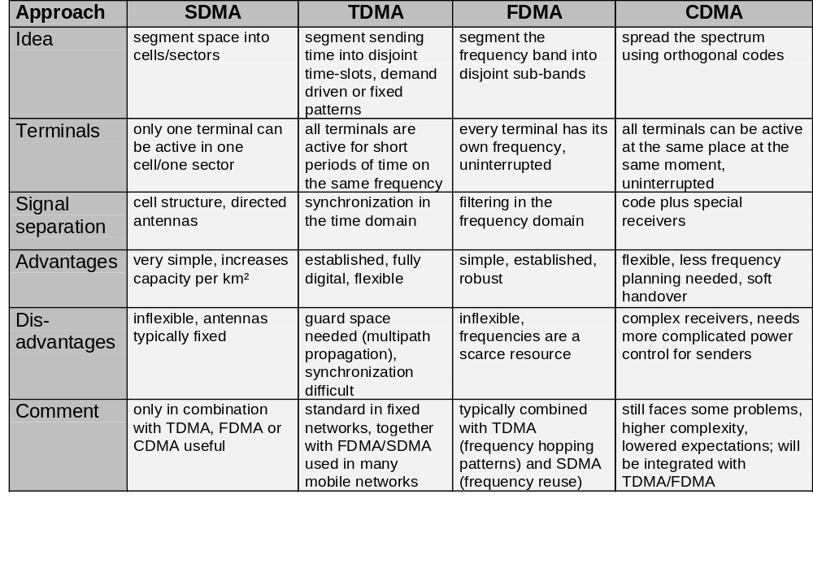
Comparison SDMA/TDMA/FDMA/CDMA

Slide 44
Error Control
Error-correcting codes/forward error correction
  include enough redundant information to enable the receiver to deduce the correct transmitted data.
  Used in unreliable channel such as wireless links
Error-detecting codes
  include only enough redundancy to allow the receiver to request a retransmission.
  Used in reliable channel such as fiber
N-bit codeword = m-bit data + r-bit check
The number of bit positions in which two codewords differ is called the Hamming distance.
Example: Hamming distance is 3.
10001001
xor 10110001
00111000 ←3 bit difference

Slide 45
Error Control
If two codewords are a Hamming distance d apart, it will require d single-bit errors to convert one into the other.
To detect d errors, we need a distance d+1 code (because there is no way to convert a valid codeword into another valid codeword with d changes. ← The detail needs mathematical analysis).
Example: A simple error - detection code: (check bit)
A parity bit is chosen so that the number of 1 bits in the codeword is even or odd.
000(0) - check bit
001 1
010 1
That is Hamming distance of parity bit code is 2 = d + 1 → can detect d = 1 error

Slide 46
Error Control - Error Correction Codes
To correct d errors, we need a distance 2d+1 code. (because d changes is not enough to recover the original valid codeword but only to convert to other valid codeword ← The detail needs mathematical analysis).
Examples: Consider a code with four valid codewords:
  0000000000, 0000011111, 1111100000, 1111111111
  Hamming distance is 5. It can correct double errors.
  If 0000000111 is received, the receiver knows the original
  is 00000011111. But if a triple errors change 0000000000
  to 0000000111, the error will not be corrected properly.
Correct → round off to the nearest codeword.

Slide 47
Error Control
m data bits → 2^{m} legal messages = codewords
Examples: Consider a code with four valid codewords:
  000000, 000111, 111000, 111111 → differ by 3
  011000, 101000, 110000, 111001, 111010, and 111100 are six invalid code words a distance 1 from 111000.
  → each valid codeword has n invalid codewords within hamming distance 1. To correct these n invalid codewords with 1 bit error, n + 1 bit patterns are required.
Since there are a total of 2^{n} bit patterns
→ (n + 1) x 2^{m} ≤ 2^{n} → (m + r + 1) x 2^{m} ≤ 2^{m+r} → m + r + 1 ≤ 2^{r}
Given m, this puts a lower limit on the number of check bits needed to correct 1 error.
m = 7 ➔ 7 + r + 1 ≤ 2^{r}, 8 ≤ 2^{r} - r → r = 4

Slide 48
Hamming Codes
Bits are numbered from the left. Checkbits are bits numbered powers of 2. {1,2,4,8, ...}. Each check bit forces the parity of some collection of bits, including itself, to be even or odd.
To see which check bits the data in position k contributes to, write k as a sum of powers of 2.
Data bits | 3 | 5 | 6 | 7 | 9 | 10 | 11
Check bits | 1 + 2 | 1 + 4 | 2 + 4 | 1 + 2 + 4 | 1 + 8 | 2 + 8 | 1 + 2 + 8
Check bits | 1 | 2 | 4 | 8
Data bits | 3 + 5 + 7 + 9 + 11 | 3 + 6 + 7 + 10 + 11 | 5 + 6 + 7 | 9 + 10 + 11

Slide 49
Constructing Hamming Codes
Consider an ASCII code H (1001000). Use even parity:
H 1001000 _ _ 1 _ 001 _ 000
Bit | Calculation | Result
1 | (1 + 0 + 1 + 0 + 0) mod 2 = 0 | 0
2 | (1 + 0 + 1 + 0 + 0) mod 2 = 0 | 0
4 | (0 + 0 + 1) mod 2 = 1 | 1
8 | (0 + 0 + 0 mod 2 = 0 | 0
The codeword is 00110010000.

Slide 50
Error Control - Hamming Codes
When a codeword arrives, counter = 0.
If a check bit k does not have the correct parity, it adds k to the counter.
Supposed there is only one bit error.
If counter = 0 → no error
If counter = 11 → bit 11 in error.
ASCII codeword
H 1001000 0 0 1 1 001 0 000
G 1100001 1 0 1 1 100 1 001
If G is received as (0) 0 1 1 100 1 001, 1st bit is incorrect.
If G is received as (1)(0){0} 1 100 1 001
1st and 2nd has errors. → 3rd bit is incorrect.

Slide 51
Error Control - Cyclic Redundancy Check
A major goal in designing error detection algorithms is to maximize the probability of detecting errors using only a small number of redundant bits.
In general, correcting is more expensive than detecting and re-transmitting.
Add k bits of redundant data to an n-bit message
  want to use k << n to detect errors
  e.g., k = 32 and n = 12,000 (1500 bytes)
Represent n-bit message as n-1 degree polynomial
  e.g., MSG=10011010 as M(x) = x⁷ + x⁴ + x³ + x¹
Let k be the degree of some divisor/generator polynomial
  e.g., G(x) = x³ + x² + 1
Polynomial arithmetic is performed modulo 2.
10011011
11001010
01010001 → EX-OR result.
Sender & receiver agree upon a generator polynomial G(x).

Slide 52
Cyclic Redundancy Check
Algorithm for computing the checksum
  shift left r bits (append r zero bits to low order end of the frame), i.e., M(x)x^{r}
  divide the bit string corresponding to G(x) into (x^{r})M(x).
  subtract (or add) remainder of M(x)x^{r} / G(x) from M(x)x^{r} using XOR, call the result T(x). Transmit T(x).
Suppose that a transmission error E(x) has occured and T(x)+E(x) arrives instead of T(x). Received polynomial T(x) + E(x) = (T(x)+E(x))/G(x) = T(x)/G(x) + E(x)/G(x) = E(x)/G(x)
  E(x) = 0 implies no errors
Divide (T(x) + E(x)) by G(x); remainder zero if:
  E(x) was zero (no error), or
  E(x) is exactly divisible by C(x)

Slide 53
CRC Example
M(x)=1101011011
C(x)=10011
k=4
P(x) = 1101011011 1110
1100001010
--------------
10011 /11010110110000
10011
-----
10011
10011
-----
10110
10011
-----
10100
10011
-----
1110

Slide 54
Selecting G(x)
Selecting G(x)
  All single-bit errors, as long as the x^{k} and x⁰ terms have non-zero coefficients.
  All double-bit errors, as long as G(x) contains a factor with at least three terms
  Any odd number of errors, as long as G(x) contains the factor (x + 1)
  Any ‘burst’ error (i.e., sequence of consecutive error bits) for which the length of the burst is less than k bits.
  Most burst errors of larger than k bits can also be detected
International standards for G(x):
CRC-12 = x¹²+x¹¹+x³+x²+x¹+1
CRC-16 = x¹⁶+x¹⁵+x²+1 ➔ 16 bit check sum.
➔ catches all single, double,odd errors.
➔ catches all burst errors of length < 16
A simple shift register circuit can be constructed to compute and verify the checksums in hardware.

Slide 55
Error Control
Convolution Coding
  Used for long bit streams in noisy channels.
  Two mechanisms: Sequential decoding and viterbi decoding
Turbo codes are a class of recently-developed high-performance error correction codes finding use in deep-space satellite communications and other applications where designers seek to achieve maximal information transfer over a limited-bandwidth communication link in the presence of data-corrupting noise.

Slide 56
Computer Networks
Internetworks
  Different networks are connected by means of machines called gateways.
  A collection of interconnected networks is called an internetwork or internet.
  A common form of internet is a collection of LANs connected by a WAN.
Network Software
  Protocol Hierarchies
  Design Issues for the Layers
  Connection-Oriented and Connectionless Services
  Service Primitives
  The Relationship of Services to Protocols

Slide 57
Protocol Hierarchies
Protocol Hierarchies
  The reduce design complexity, most networks are organized as a stack of layers or levels.
  A protocol is an agreement between the communication parties.
  The entities comprising the corresponding layers on different machines are called peers.
  The physical medium is the place through which actual communication occurs.
  Between each pair of adjacent layers is an interface. It defines which primitive operations and services the lower layer makes available to the upper one.
Network Architecture
  A network architecture is a set of layers and protocols used to reduce network design complexity.
  A protocol stack is a list of protocols used by a certain system, one protocol per layer.

Slide 58
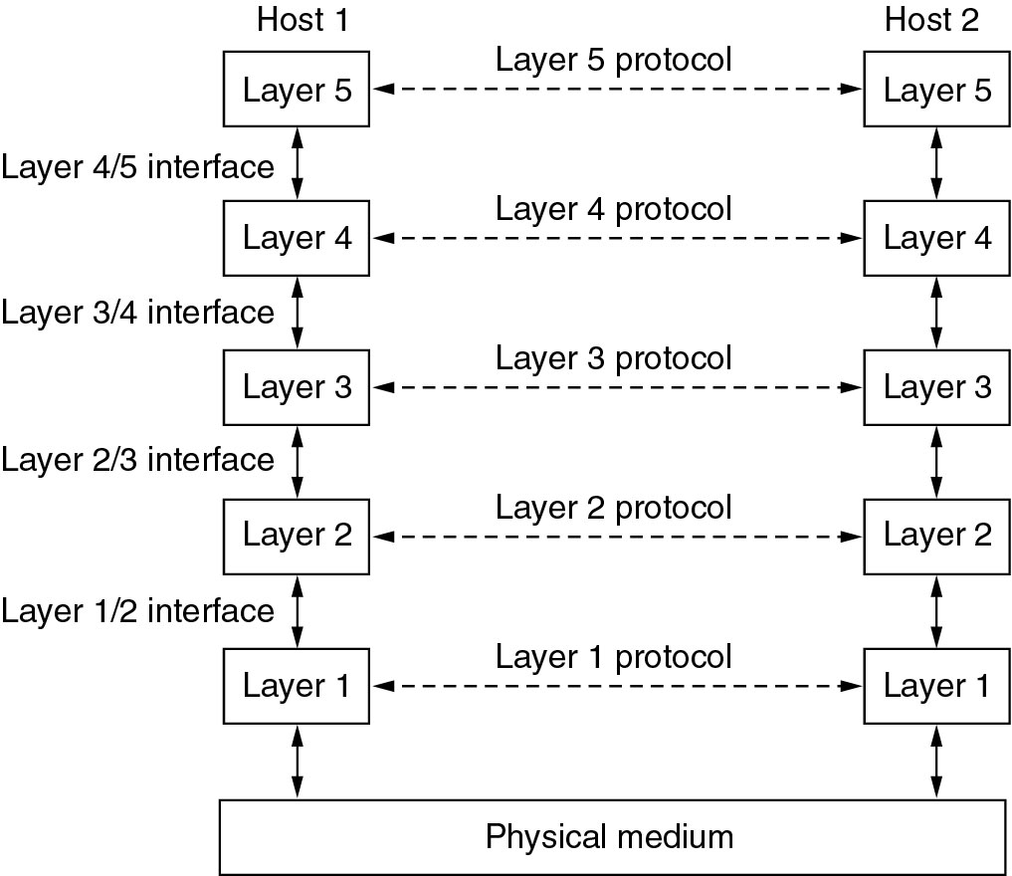
Network Software
Protocol Hierarchies
Layers, protocols, and interfaces.

Slide 59
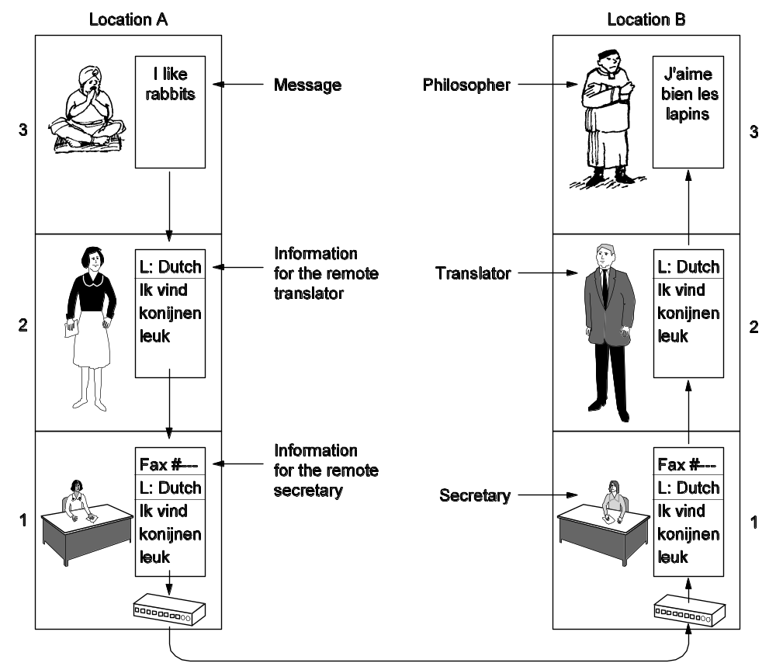
Protocol Hierarchies
The philosopher-translator-secretary architecture.

Slide 60
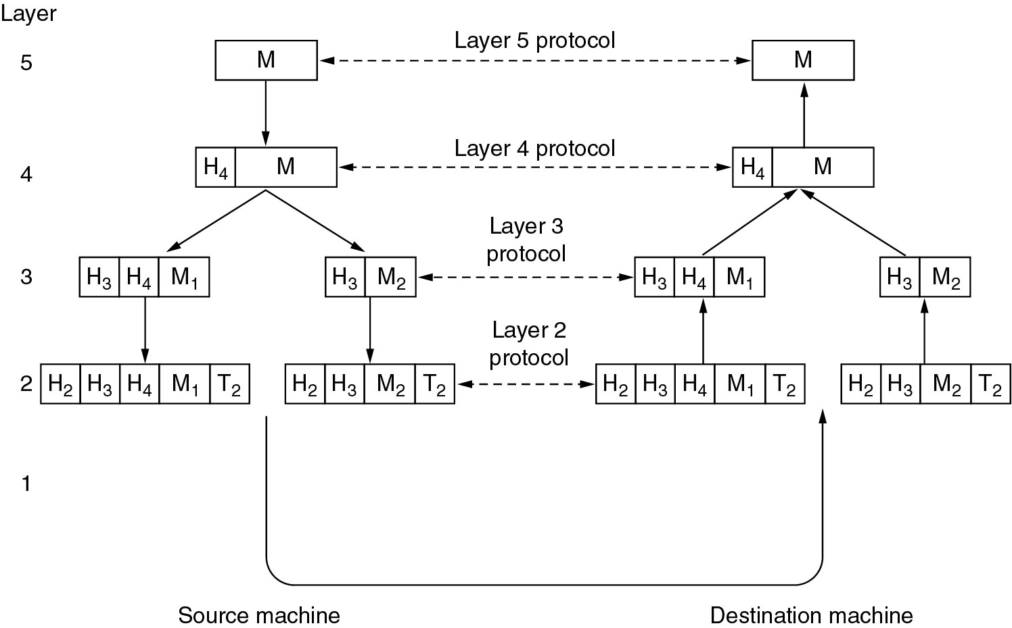
Protocol Hierarchies
Example information flow supporting virtual communication in layer 5.

Slide 61
Design Issues for the Layers
Addressing: a specific destination needs to be specified.
Error Control: errors need to be detected and corrected.
Flow Control: A fast sender is kept from swamping a slow receiver with data.
Multiplexing: the same connection is used for multiple, unrelated conversations.
Routing: a route must be chosen for a packet to transmit.

Slide 62
Connection-Oriented and Connectionless Services
Connection-oriented: connection needs to be established before communication: telephone
Connectionless (datagram): connection needs not to be established before communication: postal system
Each service can be characterized by a Quality of Service (QoS).
Request-reply: the sender transmits a request; the reply contains the answer.
Reliable communication is communication where messages are guaranteed to reach their destination complete and uncorrupted and in the order they were sent.
Why is unreliable communication used?
  Reliable communication is not available.
  The delay in a reliable service might not be acceptable such as real-time applications.

Slide 63
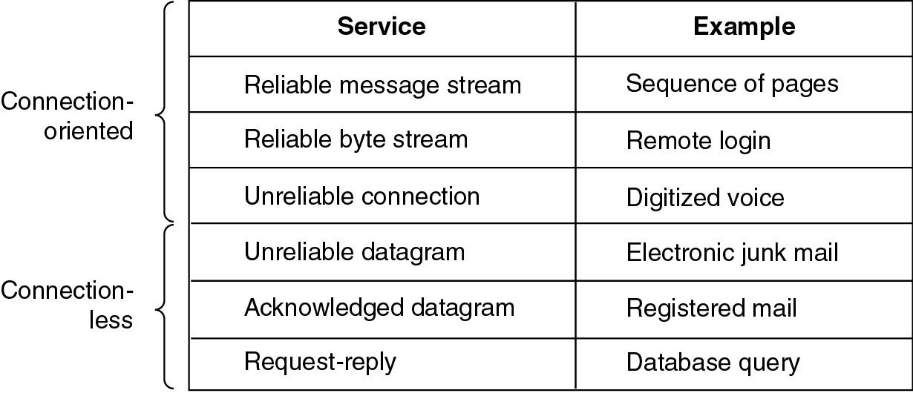
Connection-Oriented and Connectionless Services
Six different types of service.

Slide 64
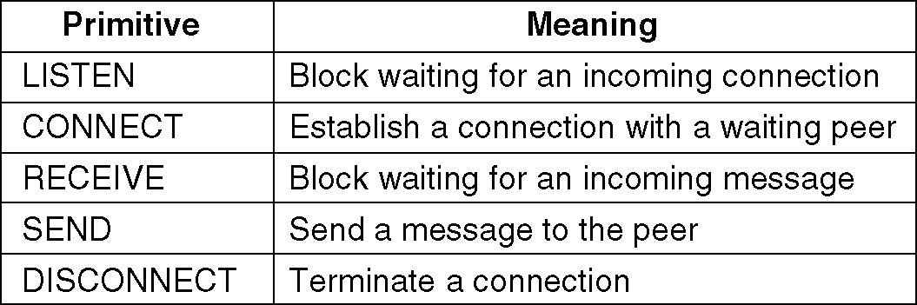
Service Primitives
A service is specified by a set of primitives (operations) available to a user process to access the service.
Five service primitives for implementing a simple connection-oriented service.

Slide 65
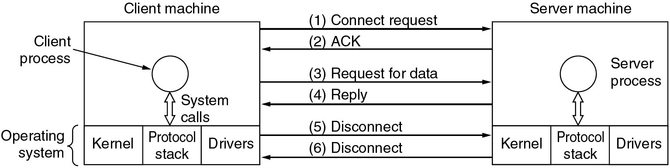
Service Primitives
Packets sent in a simple client-server interaction on a connection-oriented network.

Slide 66
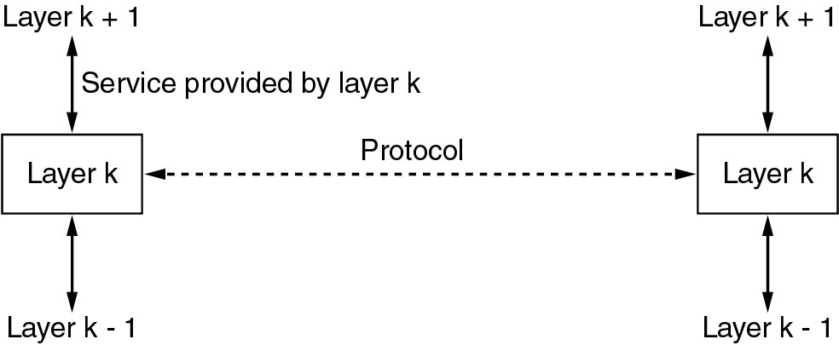
Services to Protocols Relationship
Services relate to the interfaces between layers. Protocol relate to the packets sent between peer entities.
The relationship between a service and a protocol.

Slide 67
Reference Models
The OSI Reference Model
The TCP/IP Reference Model
A Comparison of OSI and TCP/IP
A Critique of the OSI Model and Protocols
A Critique of the TCP/IP Reference Model
The OSI (Open Systems Interconnection) 7-Layer Reference Model [ISO,1984] is a guide that specifies what each layer should do, but not how each layer is implemented.
The TCP/IP Reference Model is not of much use but the protocols associated with it are widely used.

Slide 68
Reference Model
OSI Reference Model
  Physical Layer - transmission of raw bits over a physical channel.
  Data Link Layer - provide an error-free point-to-point link to transmit data and control frames (sequencing frames, retransmission) between two directly connected nodes.
  Network Layer - provide a point-to-point link between any two switching nodes (routing, congestion control).
  Transport Layer - provide a link between any two processes in two hosts (connection-oriented or connectionless).
  Session Layer - manage conversation between two peer session entities.
  Presentation Layer - present data in a meaningful format (compress, encode, and convert data).
  Application Layer - a variety of user applications (e-mail, ftp, etc.).

Slide 69
ISO 7-Layer Reference Model
End host
End host
Application
Application
Various applications (FTP,HTTP,…)
Presentation
Presentation
Present data in a meaningful format
Session
Session
Provide session semantics (RPC)
Transport
Transport
Reliable, end-to-end byte stream (TCP)
Network
Network
Network
Network
Unreliable end-to-end tx of packets
Data link
Data link
Data link
Data link
Reliable transmission (tx) of frames
Physical
Physical
Physical
Physical
Unreliable transmission (tx) of raw bits
One or more nodes
within the network

Slide 70
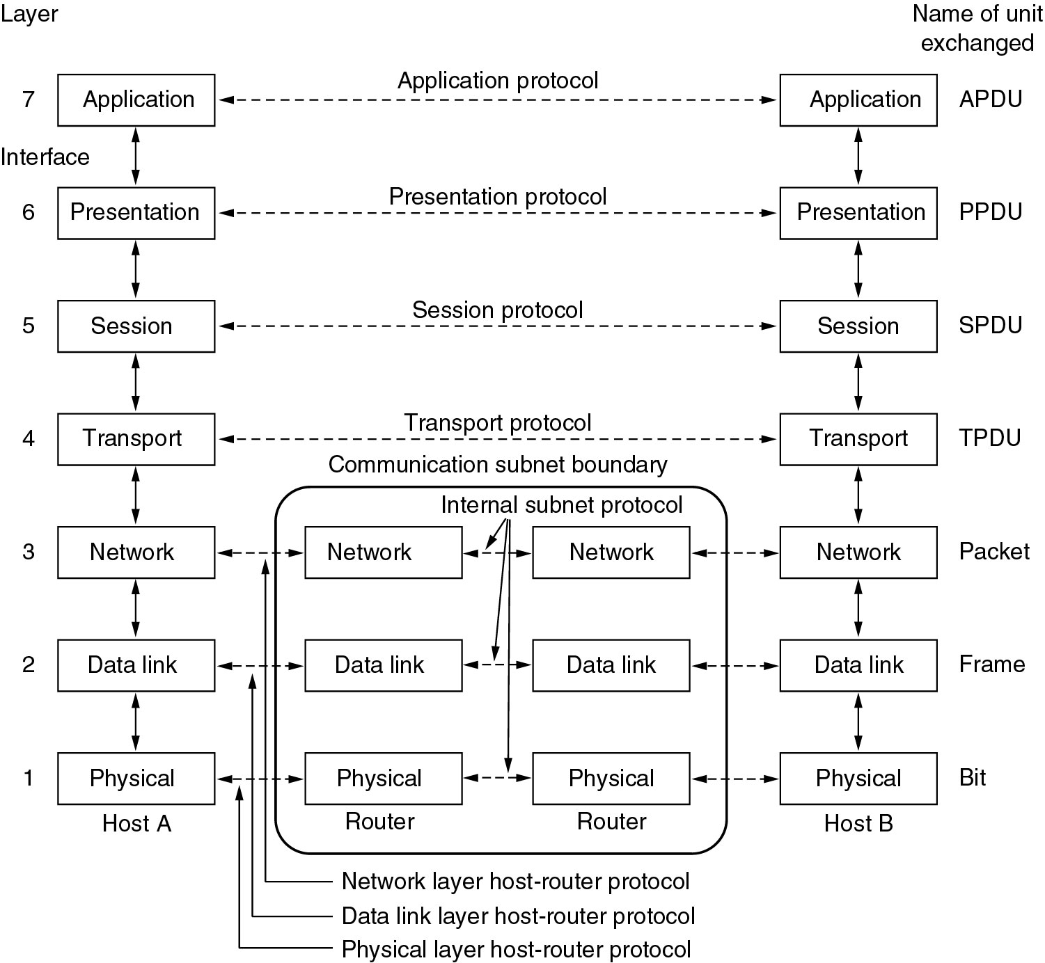
Reference Models
The OSI reference model.

Slide 71
TCP/IP Reference Model
TCP/IP Reference Model
  The internet layer defines an official packet format and protocol called IP (Internet Protocol) and specifies how IP packets are routed from the source to the destination.
  The transport layer is designed to allow peer entities to talk.
    TCP (Transmission Control Protocol) is a reliable connection-oriented protocol that allows a byte stream to be delivered.
    UDP (User Datagram Protocol) is an unreliable, connectionless protocol for applications.
  The application layer contains all the higher-level protocols.
  The host-to-network layer points out that the host has to connect to the network.

Slide 72
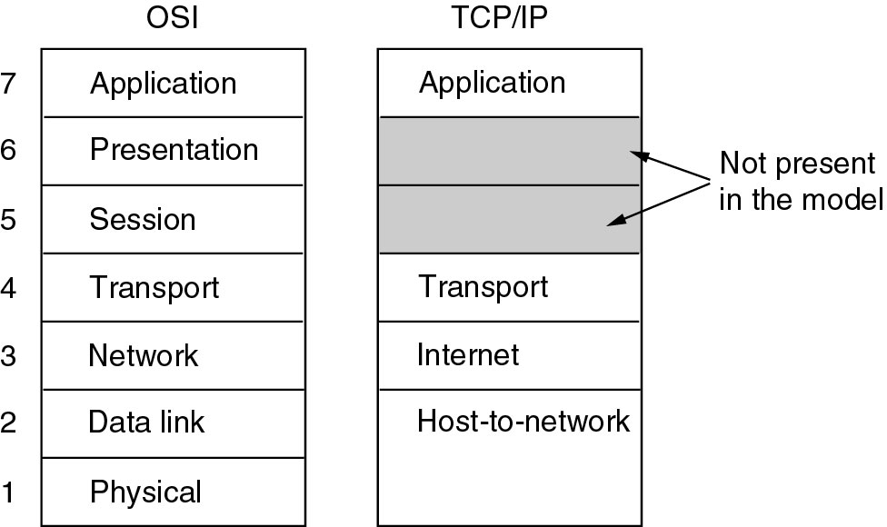
Reference Models
The TCP/IP reference model.

Slide 73
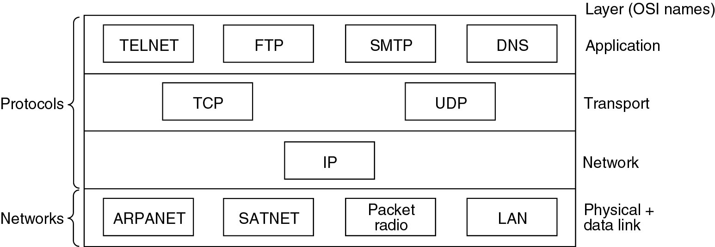
Reference Models
Protocols and networks in the TCP/IP model initially.

Slide 74
Connection-Oriented Networks
The X.25 protocol, adopted as a standard by the Consultative Committee for International Telegraph and Telephone (CCITT), is a connection-oriented network protocol.
Frame relay is connection-oriented network with no error control and no flow control.
ATM (asynchronous transfer mode) is a dedicated-connection switching technology that organizes digital data into 53-byte cell units and transmits them over a physical medium using digital signal technology.

Slide 75
Wireless LAN: 802.11
A wireless LAN is one in which a mobile user can connect to a local area network (LAN) through a wireless (radio) connection.
A standard, IEEE 802.11, specifies the technologies for wireless LANs.
It is designed to work in two modes:
  In the presence of a base station: access point
  In the absence of a base station: ad hoc networking
Physical Layer
  It supports three different physical layers:
    Frequency hopping spread spectrum (FHSS)
    Direct sequence spread spectrum (DSSS)
    Infrared
  Clear channel assessment (CCA): It provides mechanisms for sensing the wireless channel and determine whether or not it is idle.
MAC Sublayer follows carrier sense multiple access with collision avoidance (CSMA/CA).

Slide 76
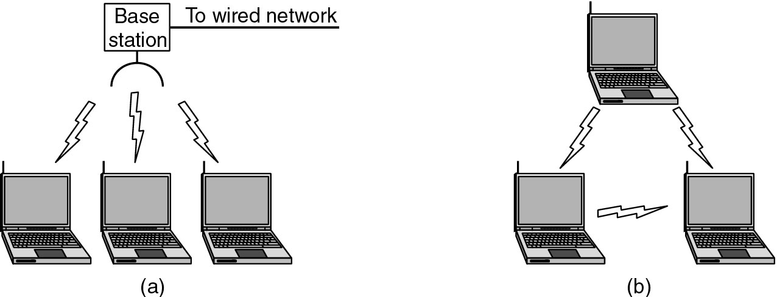
Wireless LANs
(a) Wireless networking with a base station.
(b) Ad hoc networking.

Slide 77
IEEE 802.11 Standard
The 802.11 task group has the object to develop MAC layer and physical layer specifications for wireless connectivity.
The 802.11a task group created a standard for wireless LAN operations in the 5 GHz frequency baud, where data rates of up to 54 Mbps are possible.
The 802.11b task group created a standard for wireless LAN operations in the 2.4 GHz Industrial, Scientific, and Medical (ISM) band, which is freely available for use throughout the world.
The 802.11c task group devised standards for bridging operations.
The 802.11d task group published the definitions and requirements for enabling the operation of the 802.11 standard in countries where the 802.11 standard is not adopted yet.
The 802.11e task group defined an extension of the 802.11 standard for quality of service (QoS).

Slide 78
IEEE 802.11 Standard
The 802.11f developed specifications for implementing access points and distribution systems.
The 802.11g task groups extended the 802.11b standard to support high-speed transmissions of up to 54 Mbps in the 2.4 GHz frequency.
The 802.11h task groups developed the MAC layer standard that comply with European regulations for 5 GHz wireless LAN.
The 802.11i group is working on mechanisms for enhancing security in the 802.11 standard.
The 802.11j task group is working on mechanisms for enhancing security in the 802.11 MAC physical layer protocols to additionally operate in the newly available Japanese 4.9 GHz and 5 GHz bands.
The 802.11n defines standardized modifications to the 802.11 MAC and physical layers to allows at least 100 Mbps.

Slide 79
Wireless Networks
Wireless networks are computer networks that use radio frequency channels as their physical medium for communication.
The first wireless radio communication system was invented by Guglielmo Marconi in 1897.
Radio and television broadcasting are common applications of wireless communications techniques.
The wireless communications industry includes cellular telephony, wireless LANs, and satellite-based communication networks.
In cellular networks a fixed based station serving all mobile phones in its coverage area is called a cell.
The first-generation (1G) cellular networks used analogy signal technology.
  They used frequency modulation.
  Voice communication
  Example: advanced mobile phone system (AMPS)

Slide 80
Cellular Systems
The second-generation (2G) cellular systems used digital transmission mechanisms such as TDMA and CDMA.
  Voice communication
  Example: global system for mobile communication (GSM) in Europe, IS-136 in States, Personal Digital System (PDS) in Japan.
The present system is called 2.5 G. General packet Radio Services (GPRS) has been deployed for data communication.
The third-generation (3G) systems provides services such as enhanced multimedia, bandwidth up to 2 Mbps.
  Standards: wideband code division multiple access (W-CDMA), universal mobile telecommunications system (UMTS)
The fourth-generation (4G) systems provides further improvements such as higher bandwidth, enhanced multimedia, universal access, and portability across all types of devices.

Slide 81
Wireless Local Area Network (WLAN)
The wireless Local Area Network (WLAN) is a type of local-area network that uses radio waves to communicate between nodes.
A stationary node called an access point (AP) coordinates the communication between nodes.
The two main standards for WLANs are the IEEE 802.11 standard and European Telecommunications Standards Instititue (ETSI) HIPERLAN standard.
Wireless personal area networks (WPANs) are short-distance wireless networks.
Bluetooth is a popular WPAN specification.
  Work within 10 m.
  Bluetooth Special Interest Group (SIG) including Ericsson, Intel, IBM, Nokia, and Toshiba is the driving force for Bluetooth.
The IEEE 802.15 is a standard for WPAN.

Slide 82
Ad Hoc/Hybrid Wireless Network
An ad hoc wireless network is an autonomous system of mobile nodes connected through wireless links. It doesn’t have any fixed infrastructure.
Hybrid networking combines the advantages of infrastructure-based and less networks.
  Example: multi-hop cellular network (MCN), integrated cellular and ad hoc relaying system (iCAR), multi-power architecture for cellular networks (MuPAC).

Slide 83
Network Standardization
Who’s Who in the Telecommunications World: ITU
Who’s Who in the International Standards World: ISO, ANSI, NIST, IEEE
Who’s Who in the Internet Standards World
  IAB (Internet Architecture Board)
  A Request for Comments (RFC) is a formal document from the Internet.
  IRTF (Internet Research Task Force)
  IETF (Internet Engineering Task Force)
Main sectors: Radiocommunications (ITU-R), Telecommunications Standardization (ITU-T), Development (ITU-D)
Classes of Members: National governments, Sector members, Associate members, Regulatory agencies

Slide 84
Wireless systems: overview of the development
cellular phones
satellites
cordless
phones
wireless LAN
1980:
CT0
1981:
NMT 450
1982:
Inmarsat-A
1983:
AMPS
1984:
CT1
1986:
NMT 900
1987:
CT1+
1988:
Inmarsat-C
1989:
CT 2
1991:
CDMA
1991:
D-AMPS
1991:
DECT
1992:
GSM
1992:
Inmarsat-B
Inmarsat-M
199x:
proprietary
1993:
PDC
1994:
DCS 1800
1997:
IEEE 802.11
1998:
Iridium
1999:
802.11b, Bluetooth
analogue
2000:
GPRS
2000:
IEEE 802.11a
2001:
IMT-2000
digital
2003:
IEEE 802.11g
200?:
Fourth Generation
(Internet based)
4G – fourth generation: when and how?

Slide 85
Areas of research in mobile communication
Wireless Communication
  transmission quality (bandwidth, error rate, delay)
  modulation, coding, interference
  media access, regulations
  ...
Mobility
  location dependent services
  location transparency
  quality of service support (delay, jitter, security)
  ...
Portability
  power consumption
  limited computing power, sizes of display, ...
  usability

Slide 86

Simple reference model used here
Application
Application
Transport
Transport
Network
Network
Network
Network
Data Link
Data Link
Data Link
Data Link
Physical
Physical
Physical
Physical
Radio
Medium

Slide 87
Influence of mobile communication to the layer model
Application layer
Transport layer
Network layer
Data link layer
Physical layer
service location
new applications, multimedia
adaptive applications
congestion and flow control
quality of service
addressing, routing,
device location
hand-over
authentication
media access
multiplexing
media access control
encryption
modulation
interference
attenuation
frequency

